Slide 1
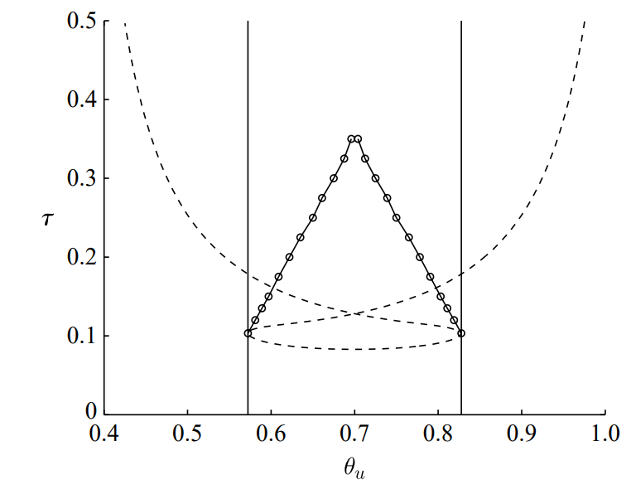


Figure 6 and 7: Stability and Bifurcations
Refer to the red dot on each slide for current position.
Key - Types of steady state
Stable fixed point
Unstable fixed point
Stable periodic orbit and unstable fixed point
Unstable periodic orbit and unstable fixed point
Fig 7 suggests unstable fixed point AND stable periodic orbit?
Notes:
Beyond bif – stable periodic orbit and unstable fixed point.
At bif – “at centre” – trajectories neither spiral in or out. Concentric circles.

Slide 3
Notes:
Look at what no delays looks like.

Slide 4

Notes:
Make green arrow red as its an unstable orbit.
Make point (circle) a solid circle.
Try initial condition at that fixed point.

Slide 5
Notes:
First diagram: add unstable fixed point to accompany stable periodic orbit.
Last: 0,0 1,1 should go t omiddle and stay, but numerical error.

Slide 9
To do:
Remove simulations (0,0) and (1,1) as they never change.
Choose example where the collision of two steady states leads to change in stability.
Thoughts: will have to set two nullclines equal to each other to find the exact values for u and v of a steady state (to witness its collision)… Or solve nullclines simultaneously? (Unsure how to get parameter values for simulation).

Slide 10
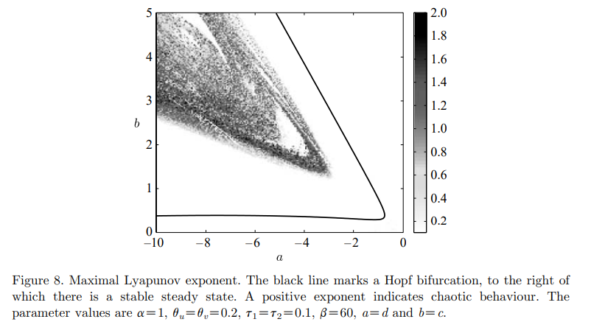
Figure 8: Chaotic/Quasi-periodic Behaviour
(-4,4.5)
(-4,3.5)
(-4,2.5)
(-4,1.5)

Slide 11
(-4,1.5)
Notes:
Still chaos.

Slide 12
(-4,2.5)
Notes:
Quasi-periodic: never repeats
Chaos: exhibits s.d.i.c
Consider: demonstrating diverging of two close initial conditions, e.g. (1,1) and (1, 0.99)

Slide 13
(-4,3.5)
Notes:
Smooth timecourse ?
Probe further: are stable points (i.e. 1,1) really stable?
Increase t
Make small pertubations.

Slide 14
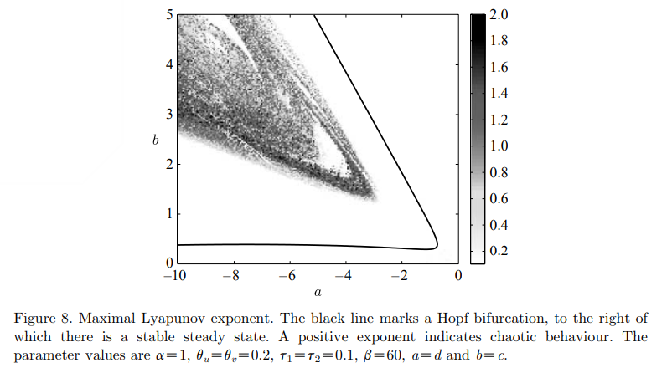
(-4,4.5)

Slide 15
To-do:
Can I elicit quasi-periodic behaviour by sampling elsewhere, or is this only dependent on beta?

Slide 16
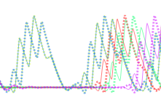
Questions
“multi-stability” – multiple steady states?
“phase locked” – no more oscillations?
“The bursting could be understood as resulting from a homoclinic tangency to an unstable limit cycle, and did not require the usual ‘slow–fast’ analysis ”
“not only detect the bifurcations of fixed points, but can also follow branches of stable and unstable periodic orbits, and homoclinic and heteroclinic orbits”
“With either inhibitory or paired excitatory and inhibitory feedback, these authors found periodic and chaotic oscillations in the firing rate of the neuron, i.e. bursting.” - lots (but intermittent) activity (i.e. figure below)?

